Slide 1
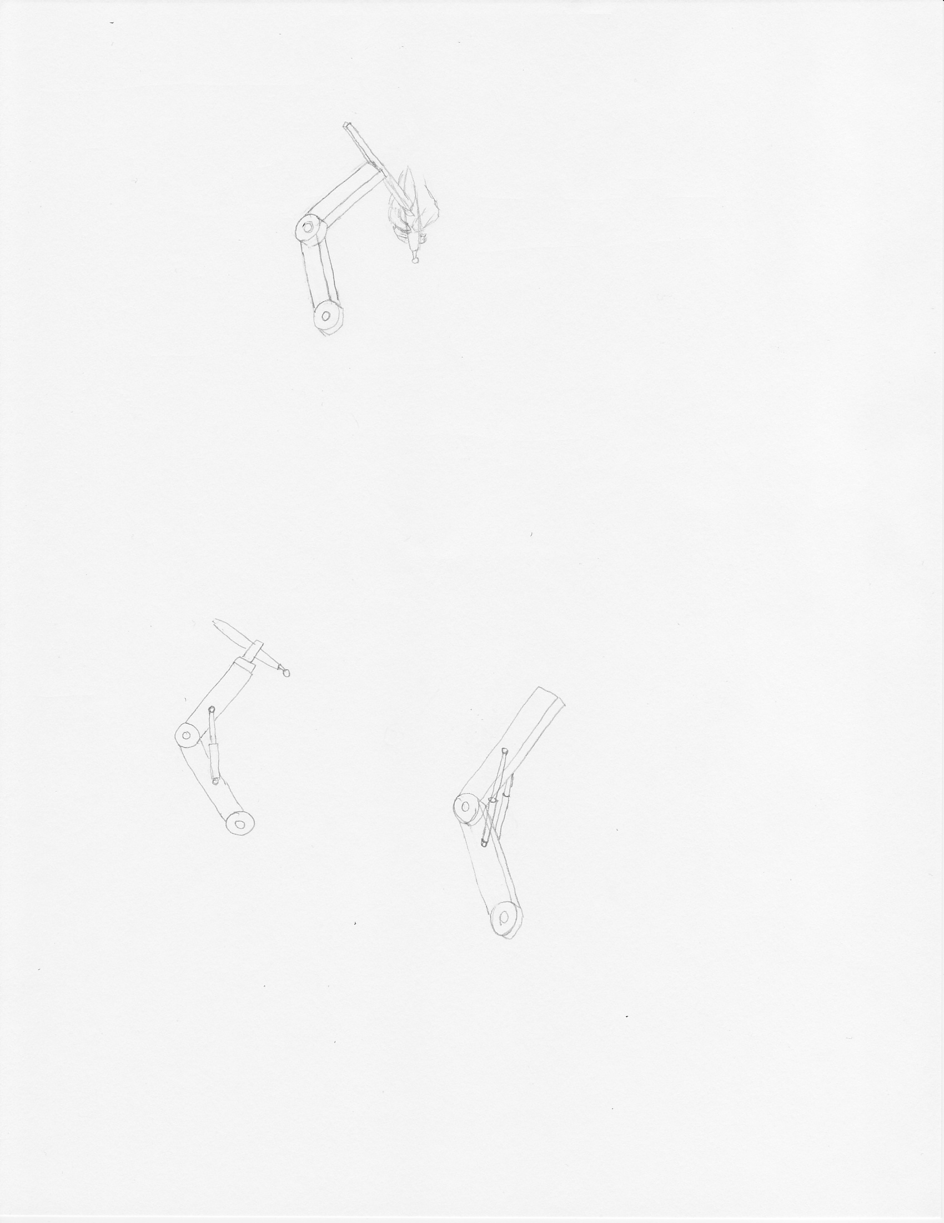
Friction
Friction in joint equal to weight

Slide 2
Damper
Hydraulic damper resisting weight

